Slide 1
Death Rate From Cancer in US Counties
Analysis for predicting death rates from cancer in US counties nationwide

Slide 2
TABLE OF CONTENTS
01
02
03
04
INTRODUCTION
DATA ANALYSIS
MODELING RESULTS
CONCLUSION
Description of the purpose of the dataset modeling
Explore some of the features and the target cancer death rate
Describe the results of the models
What we can learn from the modeling

Slide 3
INTRODUCTION
Cancer death rates in the US in 2015 was 179 deaths for every 100,000 people.
The datset has records for 3047 US counties, 33 features for each record.
We build a machine learning model to learn how to predict cancer death rates
This modeling can help us determine how the government and the population can help reduce cancer death risk

Slide 4
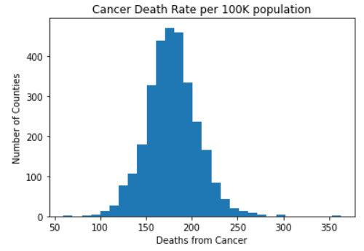
DATA ANALYSIS
Actual target data is almost normally distributed We can model the data as normally distributed

Slide 5
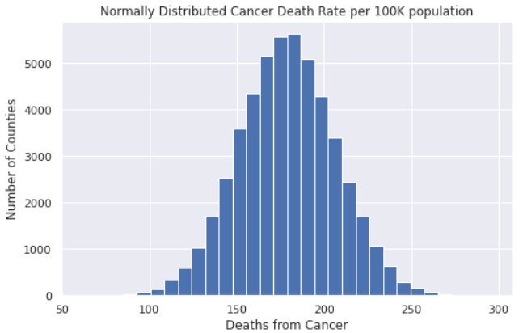
DATA ANALYSIS
95% confidence interval is [123, 234] Grouped state death rate min and max is: Utah – 135 Kentucky – 214

Slide 6
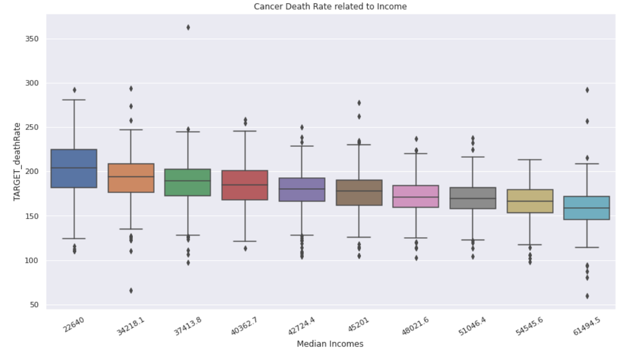
DATA ANALYSIS
Cancer death rates linearly decrease with higher incomes Lowest level has mean cancer death rate = 203 Highest level has mean cancer death rate = 159

Slide 7
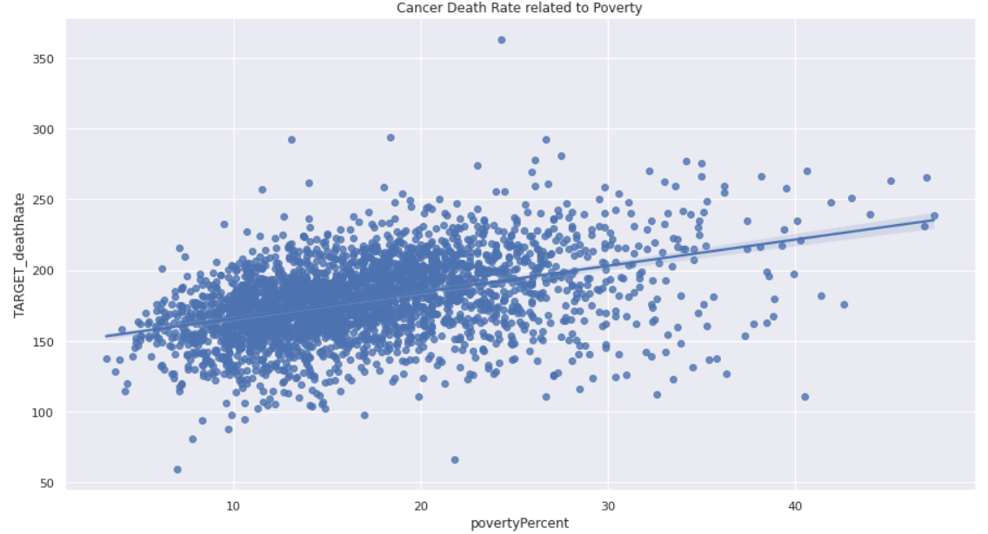
DATA ANALYSIS
By the same token, we see that cancer death rate linearly increases with poverty percentage

Slide 8
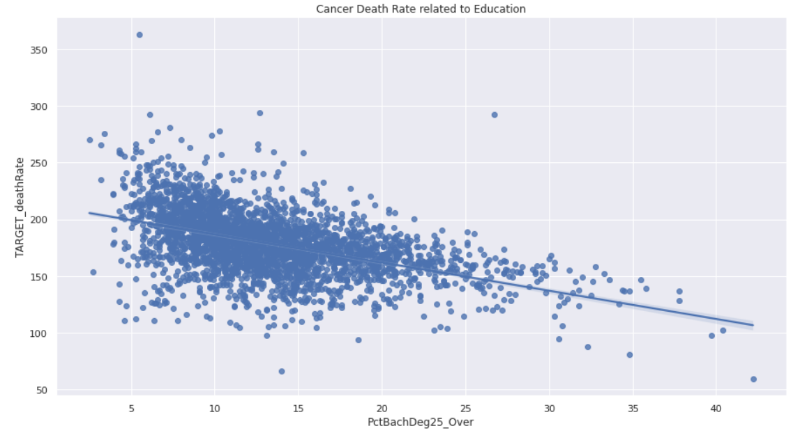
DATA ANALYSIS
Here we see how cancer death rate linearly decreases with higher education

Slide 9
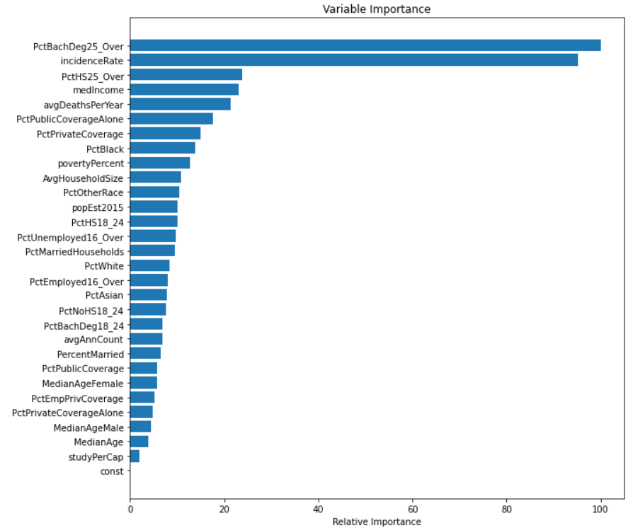
DATA ANALYSIS
Here we see how education and actual cancer rates are the 2 most important features when modeling the data

Slide 10
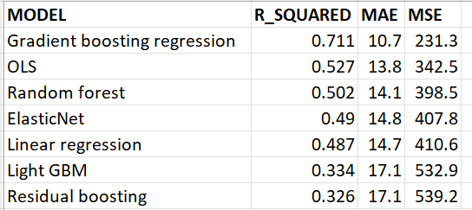
MODELING RESULTS
This is a supervised reggression problem Utilizing several different regression models, we find the model with the best metrics

Slide 11
CONCLUSION
Gradient boosting regression is the model with best evaluation metrics To reduce cancer death rates, local governments need to incentive higher education People should consider local average income levels when considering where to live to reduce their changes of cancer death

Slide 12
THANKS!
Please keep this slide for attribution

